Slide 1


Team 31: Chilly Dog
Bi-Weekly Update 4 Martin Rennaker Grant Franklin Yarentzy Magallanes Sponsor: Rohith Kumar TA: Rohith Kumar
Notes:
Michelle

Slide 2
Project Overview
Problem statement
A car parked outside on a sunny, 95-degree day can reach temperatures of up to 117 degrees Fahrenheit in just 30 minutes.
Approximately 100 dogs die in vehicles from heat exhaustion per year according to the AVMA.
Notes:
***You stop at the store just to run in for a second, and leave your pet in the car with the windows “cracked.” You’re just going to grab a couple of things, so it should all be fine. However, the lines in the store are long, you found a few extra things you needed Your pet should still be okay, though… he’s only been out there for about 20-30 minutes. Right?
Wrong.
***A car parked outside on a sunny, 95-degree Fahrenheit day can reach temperatures of up to 117 degrees Fahrenheit in just 30 minutes.
Your quick trip to the grocery store could be the determining factor between your pets life or death.
**approximatley 100 dogs die from heat exhaustion a year according to the American Veterinary Medical Association.

Slide 3
Solution
Provide ideal cabin conditions to allow your pet to safely stay unattended in a vehicle.
Features:
Does not rely on the battery or motor of your vehicle
Receive real time ambient and cabin temperature readings
Set a desired cabin temperature through the Chilly dog phone application
Receive alerts for low battery and extreme temperature conditions
Notes:
***We, the chilly dogs, have created a device to keep your cabin cool while you are away and assure the safety of your pet.
***The chilly dog is a battery powered car A/C system. that can cool the inside of your vehicle without relying on the motor of your car or its battery.
***Chilly Dog users will be able to receive real time temperature reading of the ambient and cabin temperature, adjust the desired output temperature using the chilly dog phone application, and even receive alerts when the device has low battery or conditions in the cabin become unfit for the pet.

Slide 4
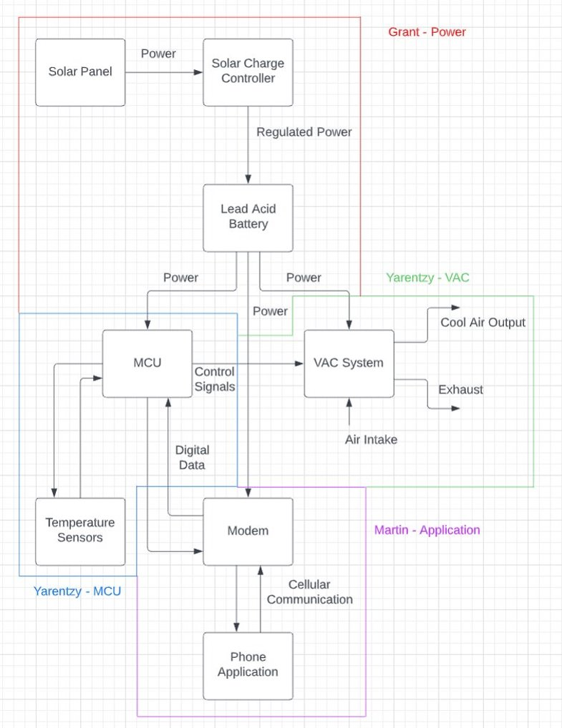
Integrated System Diagram
Notes:
Eric

Slide 5
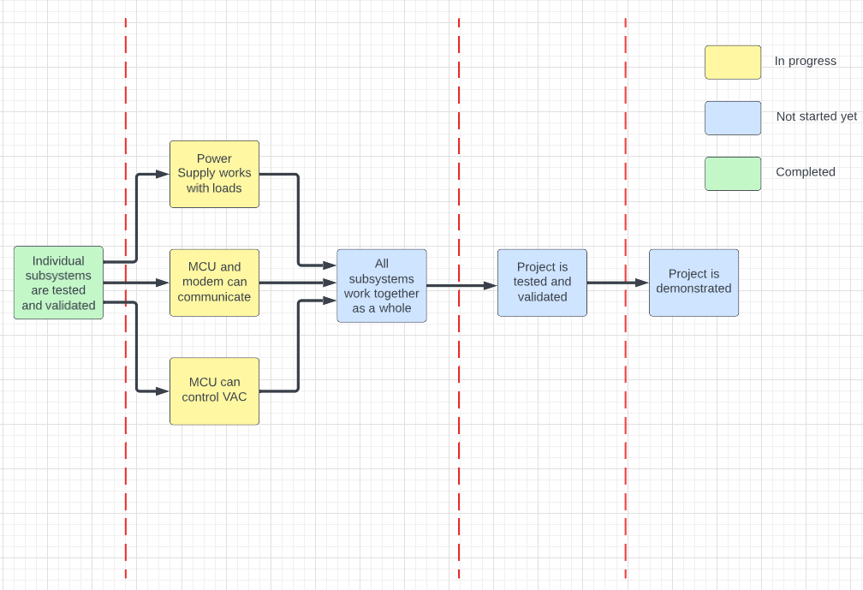
Project Timeline
8/28-9/23
9/24-10/28
10/29-11/30
12/1-12/2

Slide 6
Grant Franklin
Accomplishments since last update | Ongoing progress/problems and plans until the next presentation
Took solar charging data over 45 minutes Adjusted output power from 9V to 5V in design for integration with MCU Tested step-down converter with motors and power supply input Finished designing and ordered final PCB with all parts for the stack Measured all components in project for enclosure | Finish soldering all components onto final PCB Validate functionality of circuits with real loads and power supply input Validate functionality of circuits with real loads and battery input Validate battery life circuit with battery input Finish putting together PCB stack Put enclosure together

Slide 7
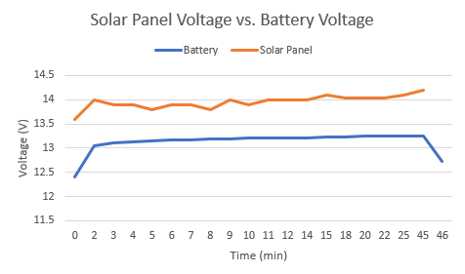
Grant Franklin
Battery charged 32mV in 45 min of direct sunlight (0.7mV/min)
To charge battery from 0-100%, it would take ~ 3hrs 45min
Charging current: 4.8-4.9A
Nominal battery voltage was found to be ~0.6V less than when charging
Nominal current across load terminals: ~0.32A

Slide 8
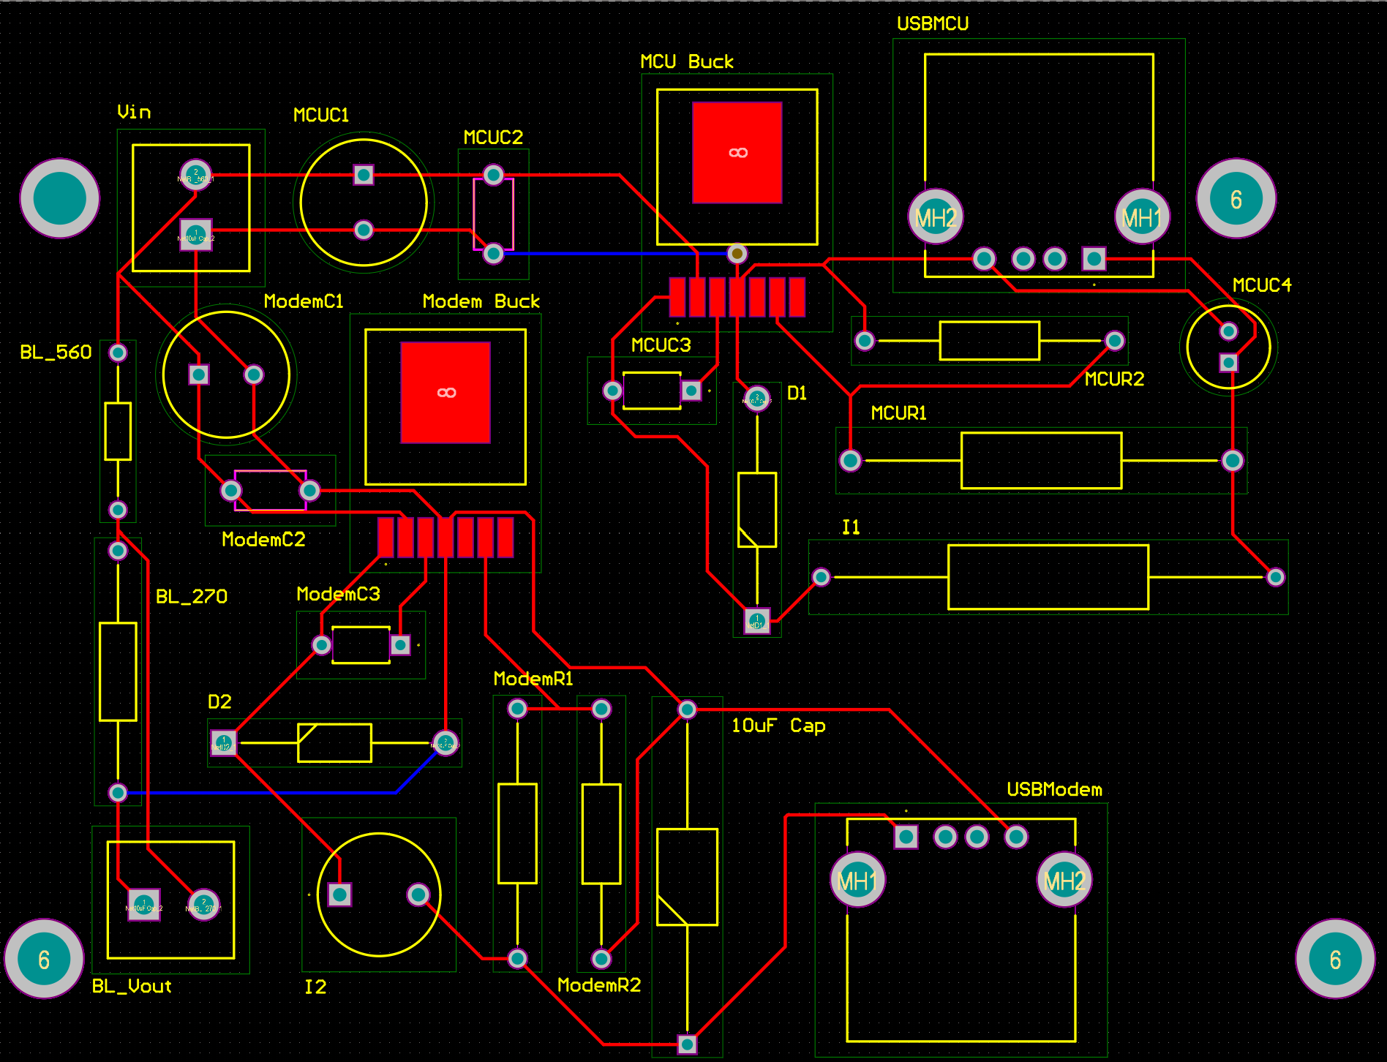
Grant Franklin
Final PCB design with 5V output to both MCU and Modem
Changed from 9V to 5V to MCU because of USB-A restraints
Using a 5V to 9V cable for correct voltage to MCU

Slide 9
Yarentzy Magallanes
Accomplishments since last update | Ongoing progress/problems and plans until the next presentation
* Verified analog input to Arduino to read battery percentage *Code takes temperature constantly until user input, makes changes and continues to take temperature. * Saving temperature after powering down | * ON-GOING SOLIDWORKS course * Create and finalize enclosure for motors * Test battery percentage code with Grant

Slide 10
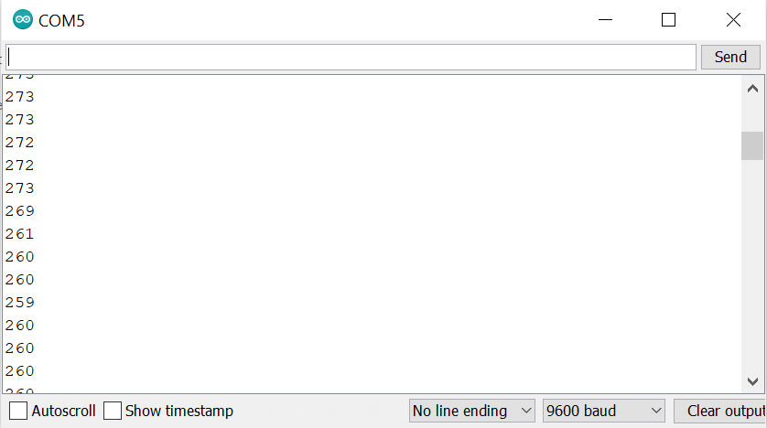
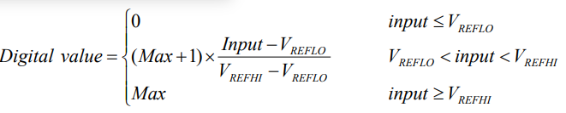
Analog to Digital Testing
The analog functionality was tested with the use of a potentiometer
Next steps: Optimize the range using

Slide 11
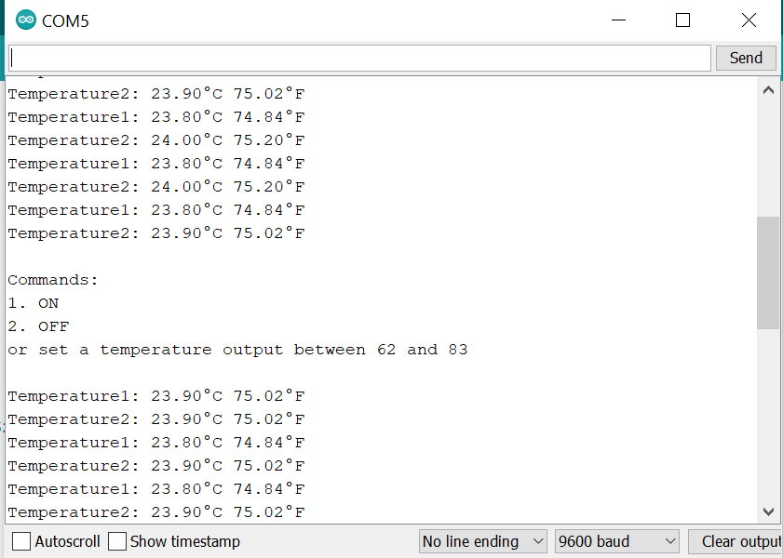
Code Continuation
Code takes temperature constantly until user input, makes changes and continues to take temperature.
Code saves last temperature after powering down

Slide 12
Martin Rennaker
Accomplishments since last update | Ongoing progress/problems and plans until the next presentation
Exhausted testing on the current modem Ordered new modem Finished iteration 1 of the enclosure Wrote program for modem with functions empty | Test that new modem can function like the old one Finish send and receive text functions Design over window clip Refine enclosure design

Slide 13
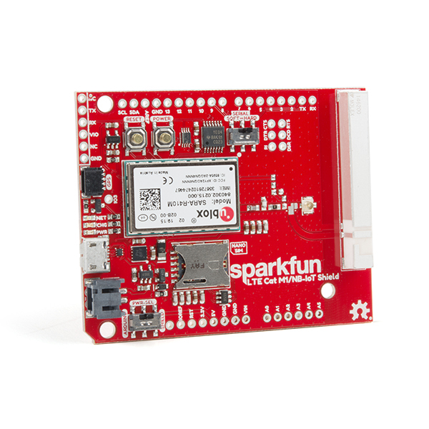
New Modem
Sparkfun LTE Cat M1/NB-IoT Shield
Designed specifically for arduino
Uses more supported and widely used library "Adafruit Fona"
Has larger and more detailed documentation
From a more widely known and supported company than waveshare
Can still be powered via micro-usb
Similar footprint to old modem

Slide 14
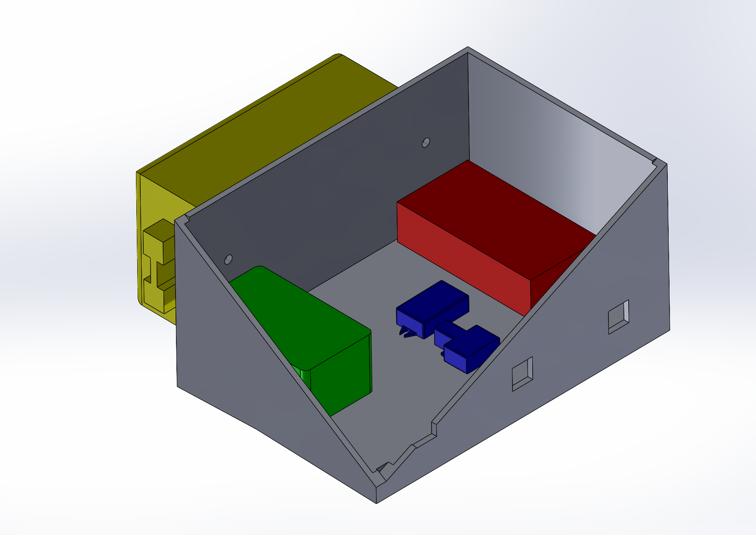
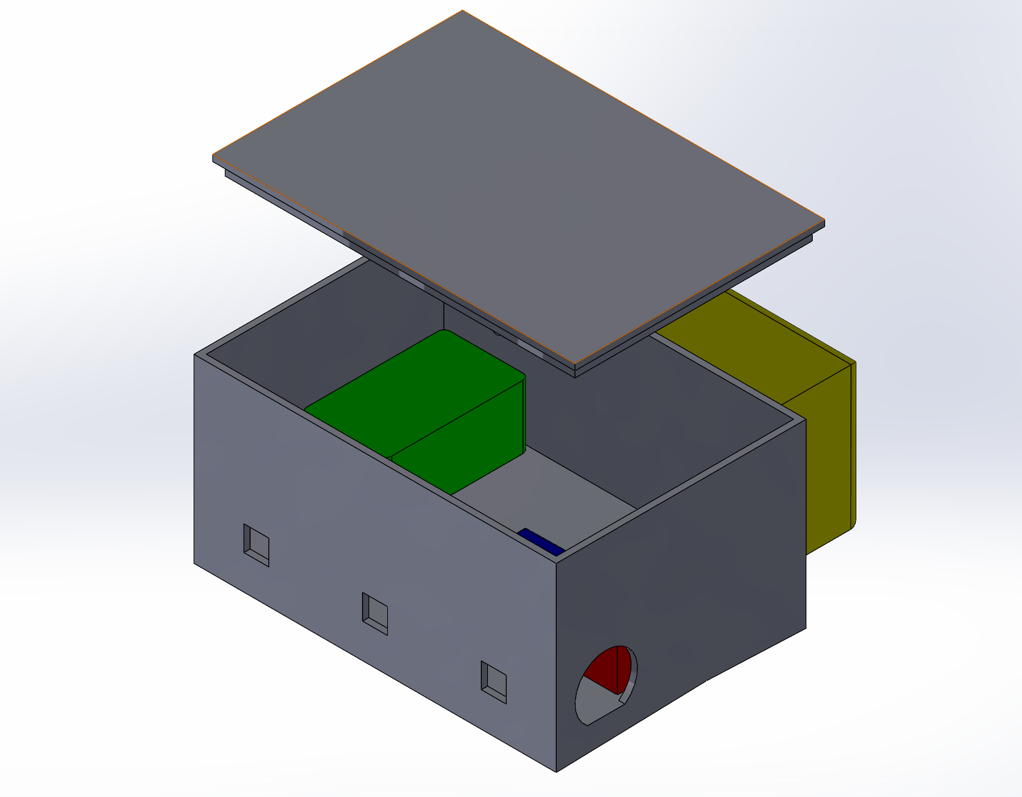
Enclosure

Slide 15
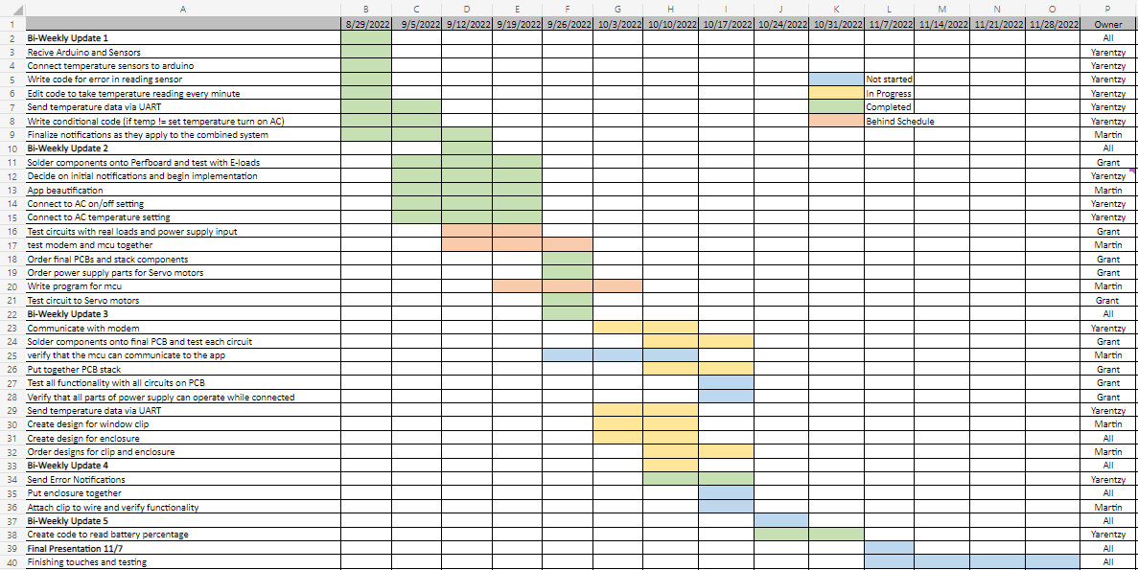
Execution Plan
Notes:
Michelle

Slide 16
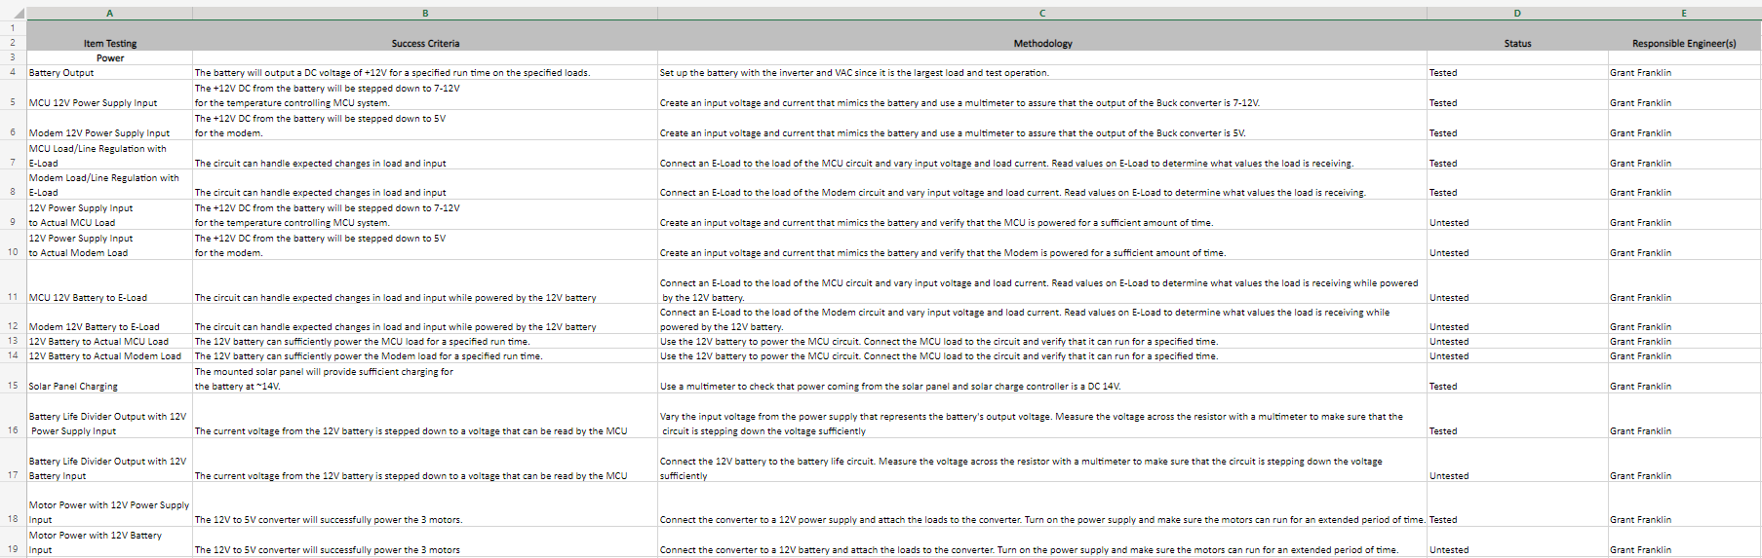
Validation Plan – Power Supply
Notes:
Michelle

Slide 17
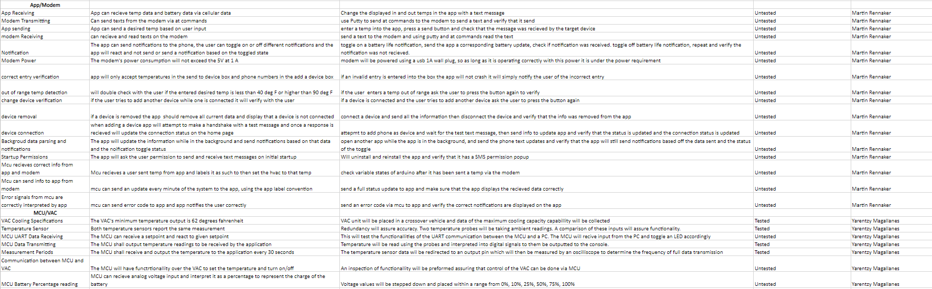
Validation Plan – MCU and Modem
Notes:
Michelle

Slide 18
Thank you – Questions?

